Slide 1
December 2022 Chapter Meeting
Organizer Timeline

Slide 2
Meeting Organizer Timeline
A meetup event for 10-100 people can be organized in just a few weeks. Here’s a suggested timeline to help make it easy to plan.
3-4 weeks before:
Getting started, find a place to host the chapter meeting. Tech companies are often willing to host meetups in their offices after hours for free; bars or restaurants with meeting areas are also good choices. Make sure they have necessary equipment needed.
Pick a date and time. Weekday evenings, excluding Friday, are popular.
Reach out to people who may be interested in speaking at your chapter meeting. If you don’t know who might speak, try:
Contact OWASP Chapter Committee visit their page and OWASP Speakers Bureau.
Ask the OWASP community
People who are active in online forums relevant to the meetup subject area.
People who work at companies that use the technology or product.
Having your first meeting be a working group, where people bring their projects, collaborate, and ask questions.
Post on OWASP chapter page, Meetup.com, secondary social media accounts to promote.
Meetup Group provide by Foundation is GDRP compliant, API compatible with OWASP chapter page, has registration, and RSVPs capabilities along with other tools. Include information like:
What topics the group will cover?
Who is speaking at the first meeting, with details about their talk?
Location, date and time information, and agenda.
Any expectations about what people should know before coming?
Once the meeting is created and posted, begin working on outreach.
Invite other local groups and their networks.
Provide the Foundation to tweet through the # amplify slack channel.
One week before:
Check-in with speakers provide the OWASP templated slides for their presentation. Follow-up to make sure the content is ready; offer help if needed.
Post more information to the attendees through the OWASP chapter page or Meetup group.

Slide 3
2-3 days before:
Send out a reminder Tweet, Facebook post, or email through Meetup to registrants.
Think about and produce any necessary signage for the space. This may include directions to the check-in area, bathrooms, or food. It doesn’t have to be fancy a sheet of paper with an arrow will do.
Day of:
If you’re tracking attendance, print a list of the people who have registered or RSVPed so you can check them in. Check Meetup tools for the checklist as part of their apps.
Make sure you have the registration materials you need—do you need name tags? If you’re in an office, will people need to be chaperoned?
Order food and drink, if needed. (Expense policy)
Get in the space early to check on setup and connectivity.
Ensure wireless information is clearly posted in a place that is easy to see and will not move.
Post-Event follow-up (within one week):
Thank people for coming, and your speakers for presenting.
Gather feedback on the content quality and suggestions for the next topics in the group.
Set a date for the next meeting.

Slide 4

The use of the Meetup Group offered and paid for by the Foundation is optional and not required. The chapter leaders need to decide and submit a request if they choose to use for the OWASP chapter meeting activities.

Slide 5
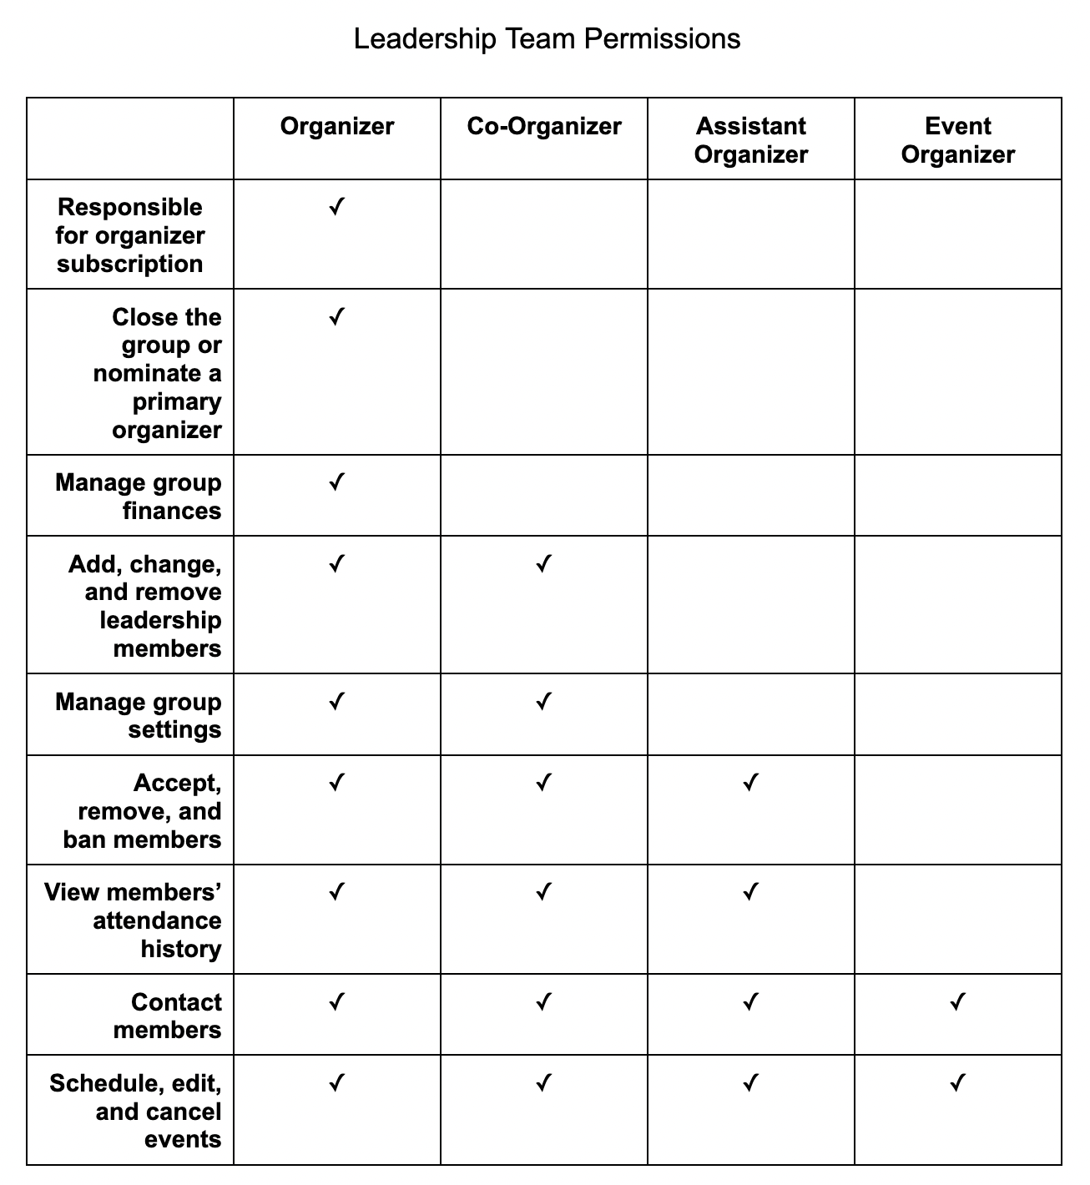
Meetup Leadership(Roles) Permission
The Foundation holds the organizer role of all groups under the Pro account. Leaders are assigned co-organizer role.
Meetup links for:
Creating and managing event on Meetup
Group and member communications - Meetup
Mastering Meetup’s features for online events.
Creating an online event with Zoom - Meetup

Slide 6
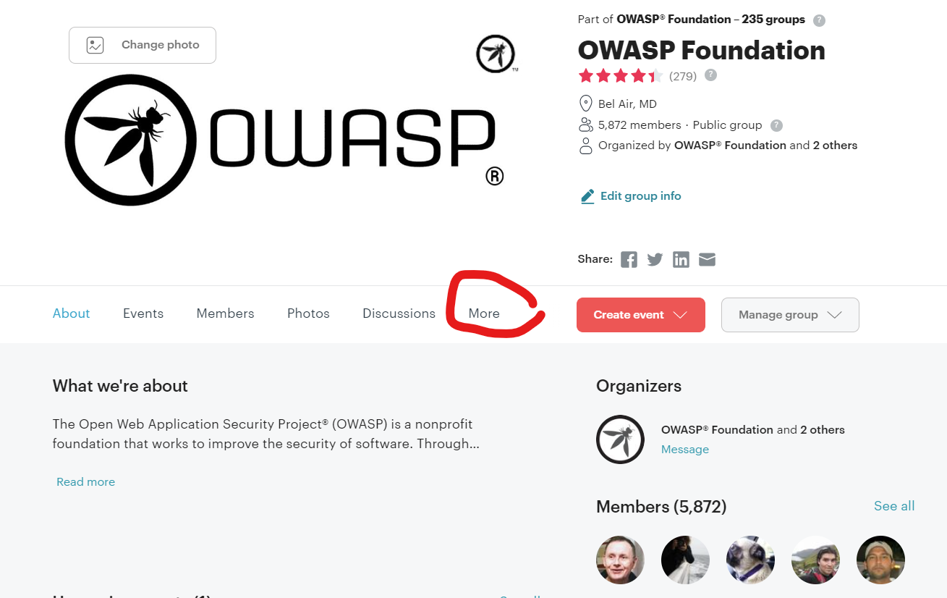
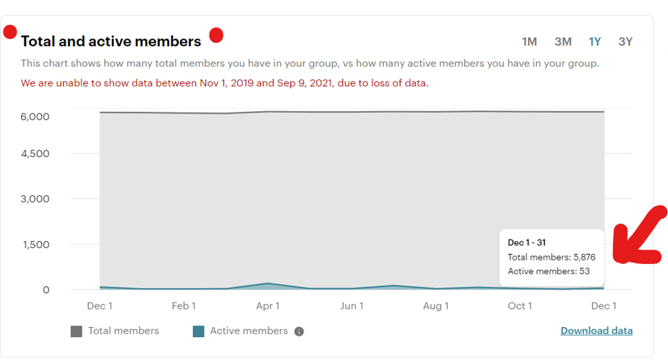
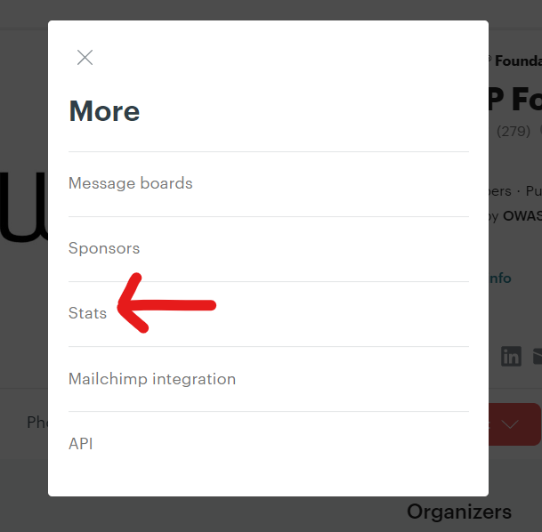
Individual Meetup Group Stats
Start at your group’s About page
Choose time frame
Click on More
Click on Stats
Only leadership team can see this page
This page was last updated at 12:00 am. The page gets refreshed every 24 hours. (By Meetup.com)

